Slide 1
Student registration form
Presented by : SARAN KUMAR.M

Slide 2
Introduction
Registration forms are used everywhere, from schools to online services
This project recreates one as a desktop application in Python
Built with Tkinter, Python’s standard GUI library

Slide 3
Project objective
Understand how to build a graphical user interface in Python
Learn to take user input and process it on a button click
Practice organizing widgets neatly on screen
Learn to store data and display it back to the user

Slide 4
Technologies used
Python with the Tkinter library
Label: field names
Entry: name and age input
Radiobutton: gender selection
Combobox: course dropdown
pack(): arranges widgets vertically
messagebox: shows the submitted details

Slide 5
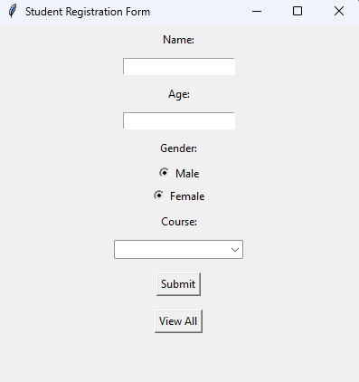
Window design:

Slide 6
Process flow
Start → Enter details → Click Submit → Save to list → Show message box → View All
Step | What happens
1. Enter details | User types Name and Age, picks Gender and Course
2. Click Submit | submit() reads the values using StringVar
3. Save | Details are stored as a dictionary in the students list
4. Display | A message box shows the submitted details
5. View All | view_all() loops through the list and shows every student

Slide 7
LIVE DEMO

Slide 8
conclusion
Built a working Student Registration Form using Python and Tkinter
Applied Label, Entry, Radiobutton, Combobox, and pack() in a real project
Learned to take user input, store it in a list, and display it back
Future scope: store data permanently (in a file or database) so it isn’t lost when the program closes, add input validation, and add more fields

Slide 9
THANK YOU

